Slide 1
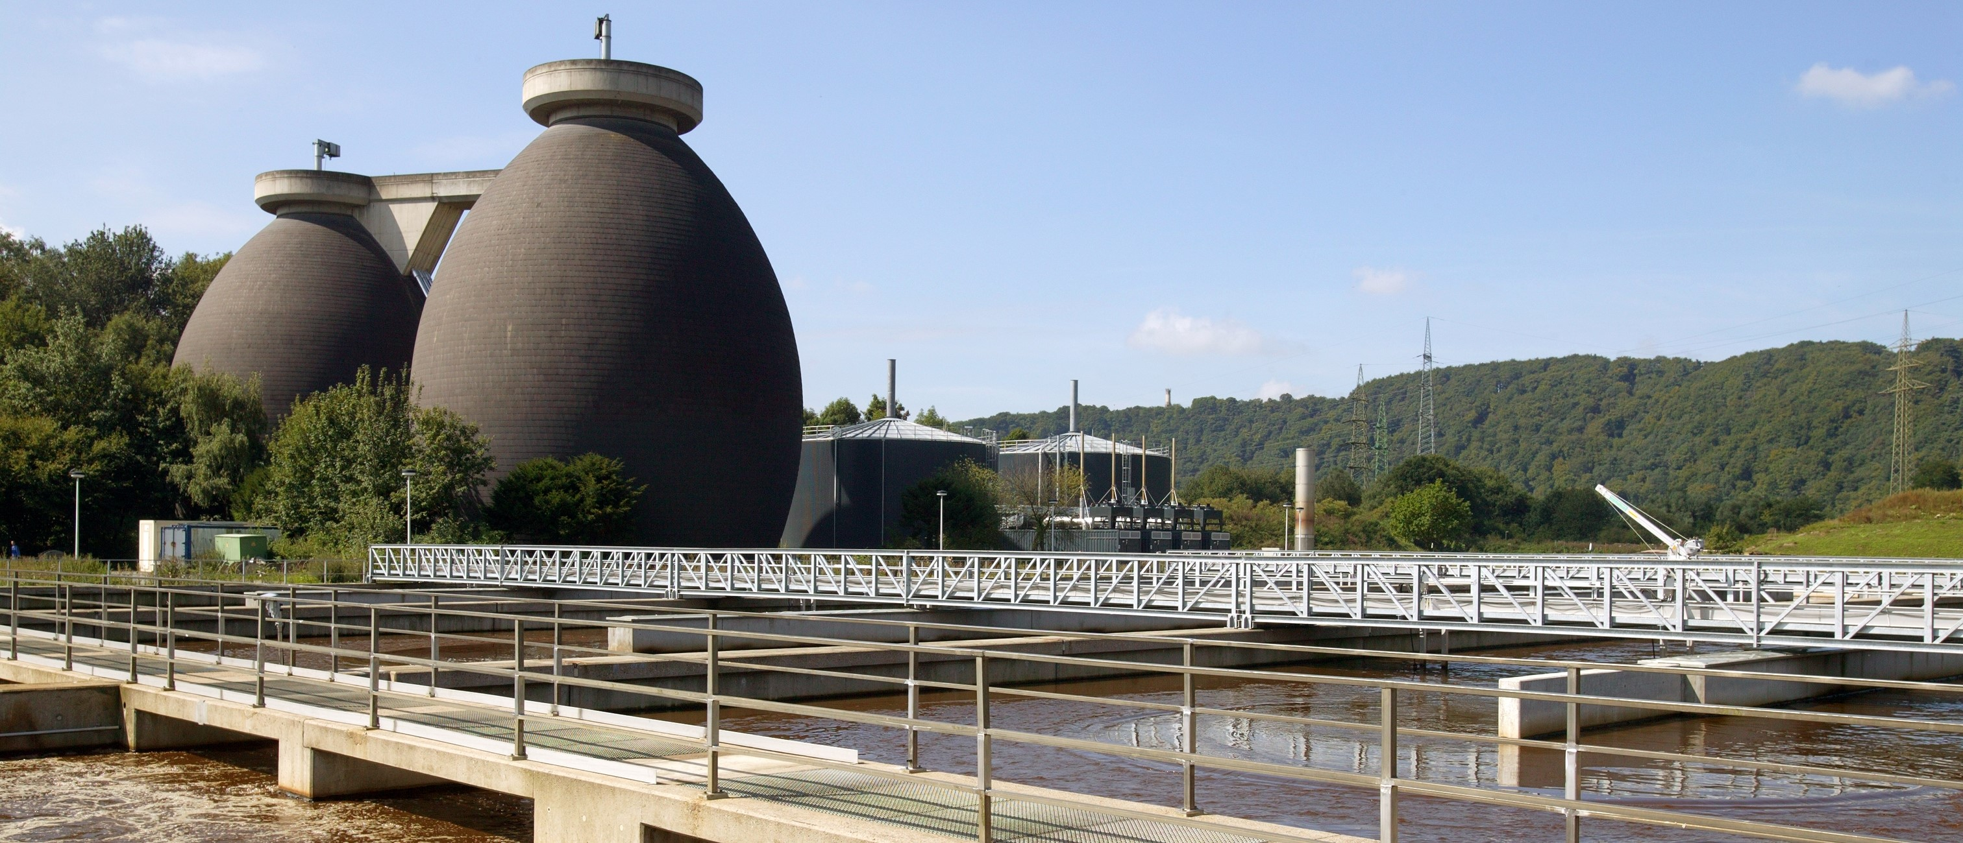
19th IWA Leading Edge Conference on Water and Wastewater Technologies
24-28 June 2024 | Essen – Germany
PRESENTATION TITLE
Author(s)

